Slide 1
Low growth in advanced economies: a fatality?
Société Royale d’Économie Politique de Belgique, 9 October 2018
Naïm Cordemans*
Economist
Economics and Research Department
* The information and views set out in this presentation are those of the author and do not necessarily reflect the official opinion of the National Bank of Belgium.

Slide 2
GDP growth has been relentlessly weak since the crisis
Real GDP growth
(annual %)⁽¹⁾
Momentum since mid-2017
Source: IMF.
(1) Dotted line corresponds to the GDP average for advanced economies, respectively between 2000 and 2007 and 2010 and 2017.

Slide 3

Is low growth a fatality? In a nutshell
Population is ageing
Q1: Are you willing to work more (hours/years)?
Old vs. new innovations
Q2: Would you give up the Internet for autonomous vehicles?

Slide 4
Low growth in advanced economies: a fatality?
Economic growth in historical perspective
Why is current economic growth low?
What caused labour productivity growth to decline?
What prospects for future economic growth?
Is low economic growth worrisome?
How to respond?

Slide 5
GDP growth has trended downwards since the 1950s
Real GDP growth
(annual %, 5-year moving average)⁽¹⁾
5.5%
5.2%
3.0%
3.0%
2.5%
1.3%
Sources: IMF, World Bank.
⁽¹⁾ Dotted line corresponds to the GDP weighed average for the decade starting in 1955, 1965, 1975, 1985, 1995 and 2005.

Slide 6
GDP growth per capita has also trended downwards
Real GDP per capita growth
(annual %, 5-year moving average)⁽¹⁾
4.3%
2.2%
2.4%
1.9%
0.7%
Sources: EC, World Bank.
⁽¹⁾ Dotted line corresponds to the weighed average for the decade starting in 1965, 1975, 1985, 1995 and 2005.

Slide 7
Economic growth is only low by post-war standards
Real GDP per capita growth in the UK
(annual%, 5-y moving average)
Real GDP per capita in the UK
(thousands of USD)
1.57%
IR3
IR2
IR1
1.27%
Source: Bank of England, Thomson Reuters Datastream

Slide 8
Low growth in advanced economies: a fatality?
Economic growth in historical perspective
Why is current economic growth low?
What caused labour productivity growth to decline?
What prospects for future economic growth?
Is low economic growth worrisome?
How to respond?

Slide 9
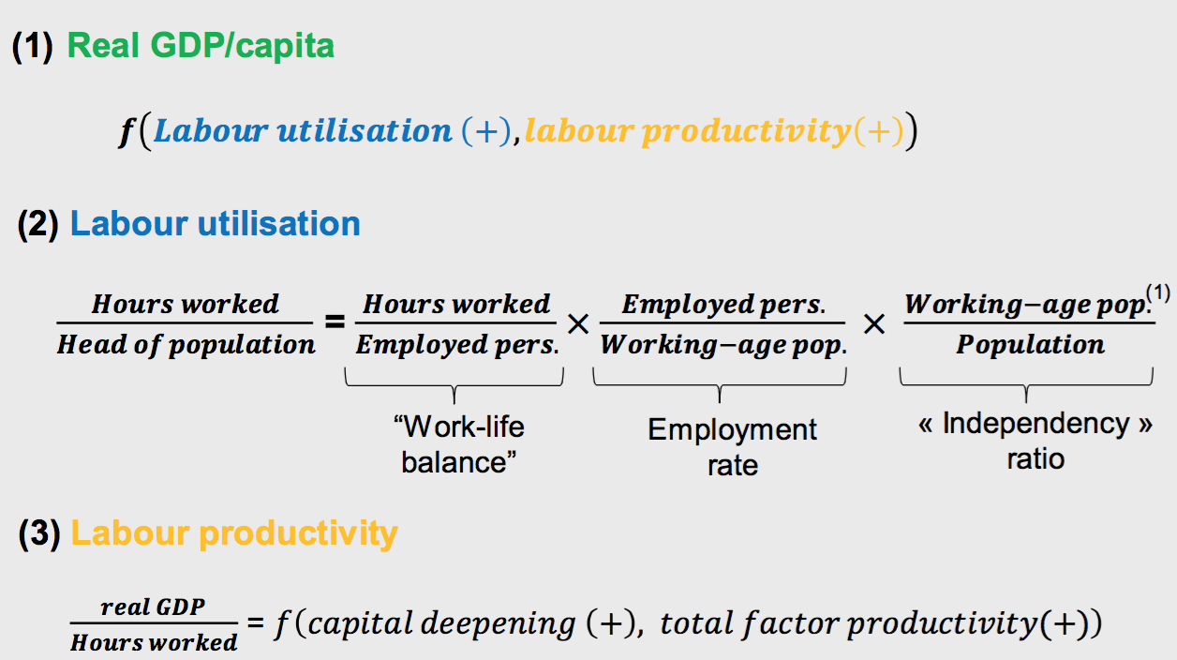
GDP/capita decomposition into labour utilisation & productivity
⁽¹⁾ Population aged 15-64y

Slide 10
Labour utilisation & productivity growth have declined
(annual % changes, 5-year moving average)
Source: OECD, Conference Board.
⁽¹⁾ Average for France and Germany before 2000.

Slide 11
Low growth in advanced economies: a fatality?
Why is current economic growth low?
  Labour utilisation
  Labour productivity

Slide 12
Population ageing and the GFC played a significant role
(annual %, 5-year moving average)
Source: OECD, Eurostat.

Slide 13
Work-life balance has dramatically improved
Average number of hours per worker
(per year)
(1)
Source: The Conference Board
⁽¹⁾ Average for France, Germany, Italy and Spain before 1995.

Slide 14
Ageing creates a significant drag on economic growth
Real GDP growth per working-age person (15-64y)
(annual %, 5-year moving average, )
Source: OECD

Slide 15
Low growth in advanced economies: a fatality?
Why is current economic growth low?
  Labour utilisation
  Labour productivity

Slide 16
Labour productivity growth has declined across the board
GDP per hour worked
(annual average growth)
(1)
Source: Conference Board, OECD
⁽¹⁾ 2016 pour la zone euro

Slide 17
Capital accumulation and TFP growth have decelerated
(annual % point contribution, 5-year moving average)
Source: OECD, Eurostat.

Slide 18
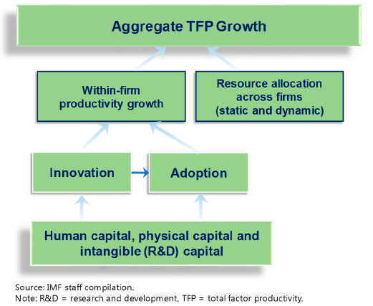
What contributes to Total Factor Productivity (TFP) growth ?

Slide 19
Low growth in advanced economies: a fatality?
Economic growth in historical perspective
Why is current economic growth low?
What caused labour productivity growth to decline?
What prospects for future economic growth?
Is low economic growth worrisome?
How to respond?

Slide 20
III. What caused labour productivity growth to decline?
Structural factors
Crisis-related factors
Measurement issues

Slide 21
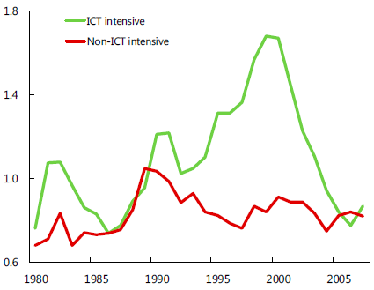
Waning ICT boom
Total Factor Productivity Growth in ICT- and Non-ICT-Intensive Sectors in Advanced Economies
(Average Across Countries, 6-year moving average, %)
Source: IMF

Slide 22
(2) Recent innovations are less “revolutionary” ?
Invention since 2000 has centered on entertainment and communication devices that are smaller, smarter, and more capable, but do not fundamentally change labour productivity or the standard of living in the way that electric light, motor cars, or indoor plumbing changed it.
Robert J Gordon, 2012

Slide 23
Is there a new “productivity paradox”?
“You can see the computer age everywhere but in the productivity statistics.”
Robert Solow (1987)

Slide 24
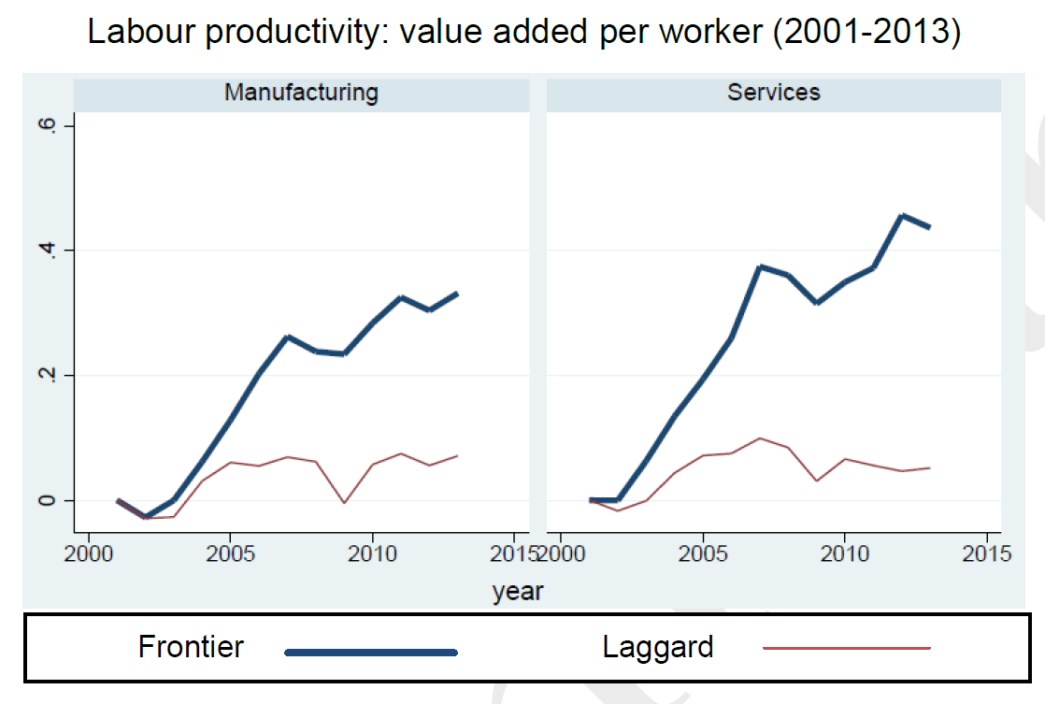
(3) Breakdown of the productivity diffusion machine
Value-added per worker
(annual average growth)
Source: D. Andrews, C. Criscuolo en P. Gal (2016), The global productivity slowdown, technology divergence and public policy: a firm level perspective, OECD background paper, 2016, figure 1, p. 15.

Slide 25
(4) An ageing workforce
(worker aged 55+, in % of total workers)
US
EA
JP
UK
Source: Thomson Reuters Datastream

Slide 26
(5) Slowing global trade integration
(world trade growth, 5-years moving average)
Source: Thomson Reuters Datastream

Slide 27
(6) Increased income inequalities
Source: OECD
⁽¹⁾ The Gini coefficient is based on the comparison of cumulative proportions of the population against cumulative proportions of income they receive, and it ranges between 0 in the case of perfect equality and 1 in the case of perfect inequality.
⁽²⁾ Palma ratio is the ratio of the income share of the top 10% to that of the bottom 40%
Notes:
- There is no single ‘smoking gun’ cause which explains both the slowdown in productivity
growth and the increase in inequality, but they could be linked in several ways.
- Growth in inequality has been exacerbated by the crisis and its aftermath which hit the incomes of
those at the bottom hardest.
The crisis hurt those on low incomes most.
Even in those countries where average income continued to grow during the crisis, half saw the top 10% do better than the bottom 10%.

Slide 28
Elevated wealth inequalities
Source: OECD

Slide 29
(7) Declining pace of educational attainment growth
People of 25y and over with 4y college degree or more (US, percentage of total, annual growth rate, 5-year moving average)
Population aged 30-34 with tertiary educational attainment
(Euro area, % of total population)
Source: U.S. Census Bureau, Eurostat.

Slide 30
III. What caused labour productivity growth to decline?
Structural factors
Crisis-related factors
Measurement issues

Slide 31
(1) An adverse feedback loop
2. Decline in
fixed-investment &
intangible capital
1. Decline in aggregate demand
(debt overhang, credit constraints,
weak balance sheets,
uncertainty, unemployment,
low wage growth etc.)
3. Subdued labour
productivity growth
(prospects)

Slide 32
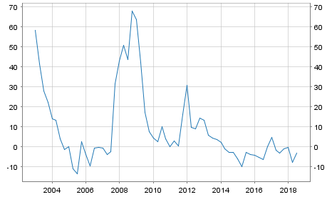
Credit constraints
Credit standards in the euro area
(Tightened minus eased or reverse)
Relationship between TFP growth and credit
(X-axis: getting credit (average 2003-15); distance to frontier, where frontier = 100; Y-axis: TFP growth (average 2000-15).
Source: ECB, Bank Lending Survey.

Slide 33
Slow recovery of investment
Investissements outside residential construction since the 2008-2009 crisis
(% of GDP, index 2007 = 100)
Total investment
(index, real terms)
Source: OECD.

Slide 34
Build-up of debt and debt overhang
Credit to NFC
(1970-2016, % of GDP)
Household debt
(1970-2015, % of disp. income)
Gross Government debt (1970-2017, % of GDP)
Source: BIS, Thomson Reuters Datastream.
Notes:
Post-crisis slowdown in growth rate of GDP has been particularly pronounced in Europe

Slide 35
(2) Hysteresis effects create loss of human capital
Long-term unemployment
(percentage of active population)
Source: OECD
Notes:
Problème d’accordance en matière d’emploi.

Slide 36
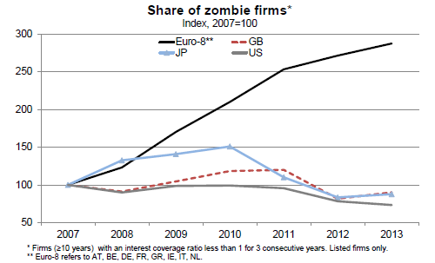
(3) « zombie firms » ¹ weighing on ressource allocation (in the euro area)
Estimate of the capital going to zombie firms¹
(% of total, 2013)
Source : OCDE.
¹ Zombie firms are defined as firms aged ≥10 years and with an interest coverage ratio <1 over three consecutive years.

Slide 37
III. What caused labour productivity growth to decline?
Structural factors
Crisis-related factors
Measurement issues

Slide 38
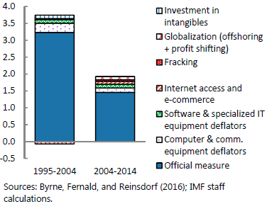
Is mismeasurement behind the productivity slowdown?
U.S. productivity growth: official and adjusted measures
Measurement error is an issue
Measurement issues affect the digital economy in particular
Mismeasurement is unlikely to explain much of the productivity slowdown

Slide 39
Low growth in advanced economies: a fatality?
Economic growth in historical perspective
Why is current economic growth low?
What caused labour productivity growth to decline?
What prospects for future economic growth?
Is low economic growth worrisome?
How to respond?

Slide 40
(1) “Demographic dividend” is in reverse motion
Working-Age population (15-64y) ratio
(% of total)
Source: United Nations
Notes:
Working-age population ratio will decline → GDP/capita growth will inevitably decline
Employment rate could be risen (certainly in the euro area)
The question about number of hours worked per workers is entire: do we want to work more? For what?

Slide 41
Yet employment rates could be raised (in the euro area)
Employment rates
(% of total population)
Source: OECD

Slide 42

(2) What potential for future innovations?
Autonomous vehicles
Research on genome
Digitalisation
Renewable energy
Artificial intelligence & robotics
To what extent will new fundamental innovations – ones that disrupt the status quo, alter the way people live and work – take place?
Advanced economies will benefit from innovations adopted elsewhere in the world

Slide 43
Gross R&D spending has been rising¹
(% of GDP)
Sources: OECD, World Bank
¹ GERD-concept = gross expenditure on R&D

Slide 44
High technology patents
(requested/granted patents per million inhabitants)
Source:Eurostat.
EPO: European Patent Office, applications, USPTO: US Patent and Trademark Office, grants.

Slide 45
Low growth in advanced economies: a fatality?
Economic growth in historical perspective
Why is current economic growth low?
What caused labour productivity growth to decline?
What prospects for future economic growth?
Is low economic growth worrisome?
How to respond?

Slide 46
GDP growth dramatically improved standard of living
Real GDP per capita in 1950 and 2014
(chained PPPs in 2011US$)
Source: Penn World Table.

Slide 47
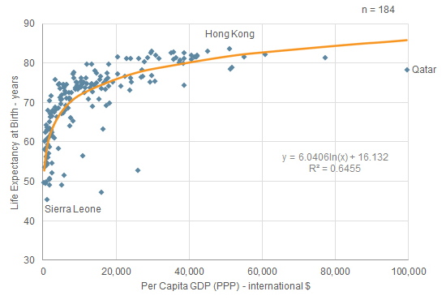
GDP per capital and life expectancy in 2012
Source: Euromonitor International.

Slide 48
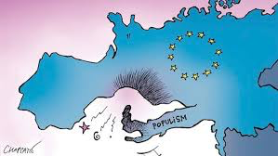
(Lack of) Economic growth and dissatisfaction
The main cause of Europe’s deep fall — the losses of inclusion, job satisfaction and wage growth — is the devastating slowdown of productivity that began in the late 1990s and struck large swaths of the continent. It holds down the growth of wages rates and it depresses employment.
Edmund Phelps
Financial Times, March 2015

Slide 49
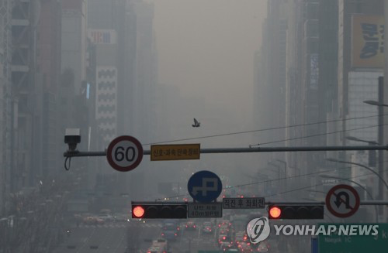
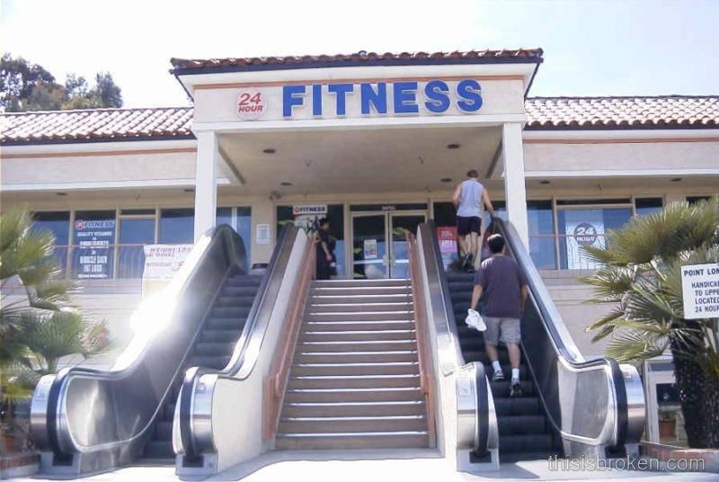
Senseless economic growth and side-effects
San Diego
Seoul
Notes:
Air pollution costs South Korea more than 10 trillion won (US$8.9 billion) a year in lost production and other damages, with the figure feared to nearly double in about 40 years, data showed Thursday.
Air pollution causes direct and indirect damage across the board by not only harming people's health, but also affecting their leisure activity and industrial production.

Slide 50

Economic growth ≠ societal progress
Notes:
GDP is a reasonably good indicator for market production flows, but it has major flaws as an indicator of societal progress
People look for better, inclusive growth, not necessarily for more
Multidimensional “well-being” (cf. Stiglitz-Fitoussi report of 2009 and subsequent works at national and international levels)

Slide 51
Economic growth quality vs. quantity
Economic growth before the crisis was artificially boosted by unsustainable credit boom. Financial regulation may reduce short-term growth, at the benefit of financial sustainability and long-term growth.
Environment has not received proper attention for long. Climate change policies and other environmental regulations may reduce economic growth, at the benefit of intergenerational well-being.
Multidimensional “well-being” (cf. Stiglitz-Fitoussi report of 2009 and subsequent works at national and international levels).

Slide 52
How to foster productivity, inclusiveness and sustainable well-being improvements?
Address crisis legacies (debt, investment, zombie firms, etc.)
Reinforce institutions & reduce policy uncertainty
Structural policies (mitigate ageing, firm entry/restructuring, tax system)
Reduce inequalities: foster opportunities (skills & education, health)
Rethink innovation & entrepreneurship policy & manage “creative destruction”
Seize the opportunities of the “green” economy (regulation)
Continue shifting the policy goal from GDP growth to well-being
  Adopt a comprehensive approach & cooperate at international level

Slide 53
Conclusions
Economic growth in advanced economies is low by post war standards
Labour utilisation and labour productivity growth contributed to the decline
Structural as well as conjunctural factors are at play
Demography will continue to weigh on growth looking forward
Potential of current/on-going innovations?
Focus on the “quality” vs. “quantity” of economic growth

